Slide 1
The Subject-Observer Pattern
IN710 Object Oriented System Design
Semester 1, 2017
Session 7.1

Slide 2
Problem Description
You have been asked to write the display software for a stationary exercise bicycle.
The interface displays three metrics based on how fast the user is pedalling.
RPM
Calories per hour
Distance (km per hour)
Assume existing hardware from which you can access the user’s pedalling speed (RPM) with an appropriate C# command (e.g. the SerialPort class).
(For this prototype, you will simulate getting data from the exercise bicycle using a button and textbox)

Slide 3
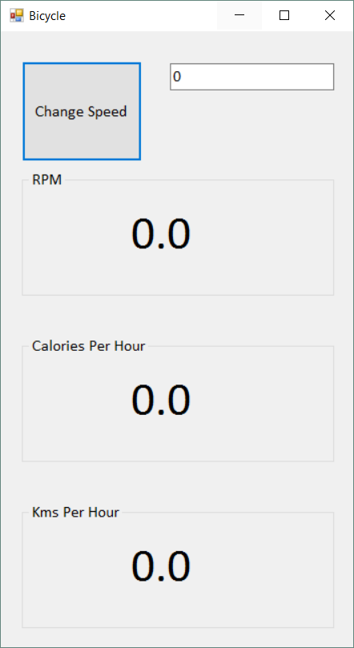
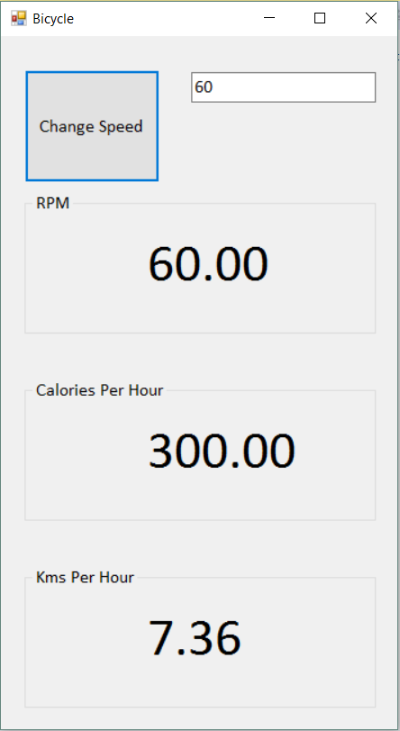
Problem Description
When the rider’s speed changes, all three displays need to be updated.
The client wants an extensible application that will allow easy addition of future displays modules.
Notes:
How will you approach this problem?

Slide 4
Solution Plan
RPM Display
Notify
User Speed Monitor
Calorie Display
Notify
KPH Display
Notify
Notes:
We need someone to encapsulate the data stream from the bicycle (e.g. the serial port that the pedals are hooked up to).
We need a number of someones to be dealing with the displays
How will the display guys know when to update? That is, how will they know when the speed has changed? There are two choices:
They can poll
The speed monitor object can push
Pushing is more efficient as no cycles are wasted on “are we there yet, are we there yet, are we there yet....”
When the speed changes, the speed monitor needs to inform all the display guys, and they need to do whatever they do to keep the UI up to date.
The classes need to be designed so that this can happen.
This is a very common situation in software
The two types of entity are called “Subject” (the guy with the data) and “Observer” (the guys who want his data) and the architecture we use is the Subject-Observer pattern.
Sometimes also called “publish” and “subscribe”

Slide 5
Responsibilities
Subject
Know who all the observers are
Add an observer
Remove an observer
Notify all observers when something happens
Observer
Accept data updates
Do something with the data

Slide 6
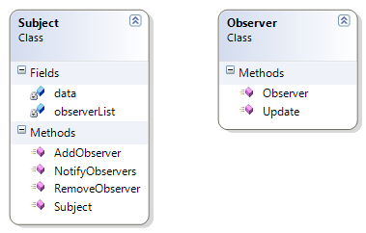
Class Schematics
Notes:
In class diagram terms, it usually looks like this......
Don’t be confused that the “subject” is actually observing the bike’s change in speed. That’s just a little terminology imperfection.
The Subject is the guy who knows when some event occurs; the Observers are the guys who have to do something when that event occurs. They are Observing the Subject.
Recall that this pattern is sometimes called “Publish” (Subject) and “Subscribe” (Observer), and if that makes it easier to understand, you can call it that.

Slide 7
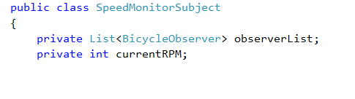
Subject Properties
Notes:
For our exercycle example, what would the Subject’s data members be?

Slide 8
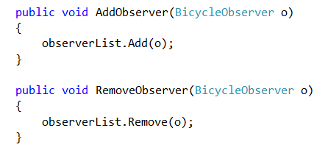
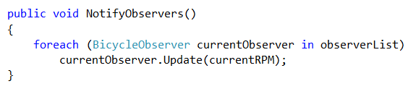
Subject Methods
Notes:
For our exercycle example, what would the Subject methods be?
Constructor just initialises the data fields (remember to create that list….)
AddObserver and RemoveObserver are just about managing elements of the list, and they simply use the list methods.
(It would not be unreasonable to do some error checking before the Remove, but this is omitted to save space on the slide.)
NotifyObservers cycles through all the observers and calls each one’s Update method, passing in the data.
Note that Subjects and Observers have a contract: Observers agree to expose this Update method with appropriate input argument(s).
This is acceptable coupling (object use that should be fairly impervious to change).
Each Observer will implement its Update method polymorphically, doing whatever it needs to do with the data.
Subject is not responsible for this.
Where is the Display logic? Doesn’t the Subject need to call each Observer’s Display method?
No. Coping with the data is the Observer’s job, and this includes figuring out how to display it.
The Subject’s job is just to say “The thing I’m monitoring happened. Here are your new data values.”
Note that the implementation we are going to start with allows some coupling between the Observers and the UI – they are going to have controls to display their data in. This is a simplification that allows us to concentrate on the core part of the Pattern – the Subject/Observer relationship. Later in the semester, we will see a couple of options for reducing this coupling.
The NotifyObservers method is called whenever the Subject detects a change in the data that it is monitoring.
IRL, that would happen when the person on the exercycle changed speed. In this simulation, it will happen when the button is clicked.

Slide 9
Joining the List of Observers
Observers add themselves by calling the Subject’s AddObserver method.
Observers must have a reference to their Subject.
The Subject is passed into the Observer’s constructor call.
Notes:
How will an Observer get added to the list?
Say I want to put a new display on my bicycle dashboard.
How does the Subject know he has a new observer?
One option is to have some kind of managing class that knows about the subject and knows about the new display, and it can call subject.addObserver(newguy).
Any alternative?
The way it is usually done it to let the Observer be responsible for adding itself.
Just the way that, if you want to subscribe to a magazine, you get in touch with the magazine publisher. (You probably don’t have a managing class who subscribes for you.)
To make this happen, you must pass the Subject into the Observer in its constructor . The Observer then adds itself.
This architecture ensures that the Subject is always added correctly, and also that it can remove itself, or make contact with its Subject(s) should it need to.
Let’s look at this Observer class in detail.

Slide 10
Observers
Fields to hold:
Input data
Computed data value
Display controls
Subject
Methods:
Update
Display
Notes:
All Observers have:
Input data: what they get from the subject
Computed data value: What they compute from the input data. For example, one of our observers will convert RPM to calories per hour. They should have somewhere to hold that computed value.
Display controls: They will need these, as the Form never talks directly to the Observers in this architecture, so cannot pass in their display controls as a method argument to the Display function (again, we will see an alternative in a few weeks that eliminates this coupling).
All Observers have:
Update and Display methods.
Update accepts the new data value and contains whatever computation is involved (computation probably has its own method).
Display puts the computed value to the screen control.
Obviously, with so much common data and functionality we are looking at an inheritance hierarchy.
The base class will contain all the fields as protected members. There will be common code in the parent constructor.
What about the methods? Concrete, virtual or abstract?
Update: Virtual (if there is a default) or abstract (if there isn’t) depending on the problem. Not concrete, as there wouldn’t be much point in having multiple observer classes who did exactly the same thing with their data.
For this problem, there is no default update behaviour, so make it abstract. Or argue that the guy just flicking the data on as RPM is the default and make it virtual. I think the former is a little clearer, but have no strong preference assuming everything is well-documented.
Display: For this problem, everyone simply writes their computed value out to their label control, so the method can be implemented concretely in the base class.
So….

Slide 11
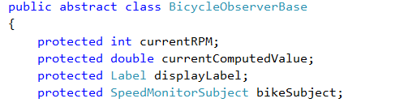
Observer Base Class
Notes:
Here are the fields….
What’s that SpeedMonitorSubject? => That’s the class of the Subject (or Publisher, if you prefer).

Slide 12
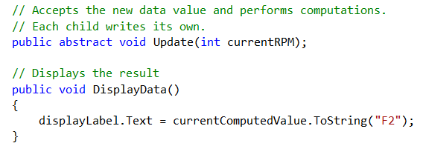
Observer Base Class
Notes:
The non-constructor methods (we will look at the constructor next, as it is the most interesting one)
We will look at the various implementations of Update (as it is abstract, each child will have to implement it) in a minute

Slide 13
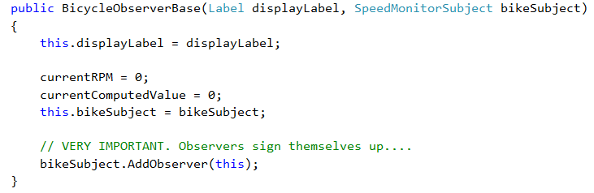
Observer Base Class
Notes:
And here is the constructor
Note the “subscribe yourself” step.
Placing it here in the base constructor guarantees that every observer child will be correctly subscribed to his subject.

Slide 14
Form Code
Notes:
Left as an exercise in the practical.
As we have been seeing, there won’t be much of it.
Basically, create all the participants in the Form_Load. Create the Subject first and pass it into each Observer’s constructor call.
Everything will then be wired up correctly.
The button click handler simply reads the “pedalling speed” from the text box, and sends it off to the Observer, who then calls its NotifyObservers method, passing it along.
And everything just happens.
NB: WHERE DOES THE FORM CALL THE OBSERVERS’ UPDATE METHODS TO GET THE SCREEN TO CHANGE? => It doesn’t. Only the Subject does that.

Slide 15
The Observer Pattern
The Subject monitors some state, which changes.
The Subject holds a list of Observers
Observers add themselves to this list when they are created (i.e. in their constructor).
When the state changes, the Subject notifies all the Observers, passing the new state information.
When notified of change of state, the Observers do work.
Notes:
Summary:
So this is the Observer pattern.
It’s quite common.
We will look at a familiar instance of it in a moment…

Slide 16
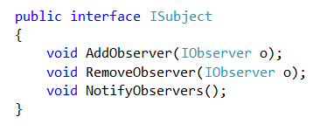
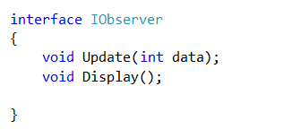
Code Reuse
Notes:
The Observer Pattern is very common.
You might have many Subject-Observer groups running at the same time in an application or system.
How might you make your architecture more general, to allow for this situation?
Consider defining the Subject and Observer behaviours as interfaces.
Let your concrete classes implement the interface.
Note that an object that implements ISubject can take any kind of object that implements IObserver. They don’t all have to be from a common family as in our non-interface implementation (where the Subject held a list of BicycleObservers).
We could make the IObserver interface more general by using object as its input data type to the Update method (or making a generic)
.
Both of these choices can introduce the need for more type-checking and casting.

Slide 17
Coping with Change
Notes:
Recall that your client wanted to be able to add new displays at will.
What will that involve?
Simply descend a new Observer (implement interface if using one).
Pass in the Subject when creating him.
The Subject will then call the new guy’s Update method when he executes NotifyObservers, because it will be in his list.
No change to the Form other than creating the new Observer instance.
No change to the Subject code is required at all
Isn’t that elegant?

Slide 18
A Familiar Observer Pattern
Notes:
You actually use a flavour or the Observer Pattern all the time.
Ideas where? => .NET Event handling (i.e. button-click handlers, timer tick code, etc.)
In this version, the Observers are instances of the .NET EventHandler class.
EventHandlers take a function as an argument to their constructor, and hang onto it (sort of like JavaScript). This is their “Update” method.
The syntax involved is a little sticky (because of the generality requirements) and we will look at it in detail in a couple of weeks.
But the architecture should be clear:
When you write a button click handler, the system creates an Observer for it (an instance of System.EventHandler).
The button object itself is the Subject. He holds a list of EventHandler Observers.
He can actually hold many such lists, one for each type of Event he can respond to.
The system adds the Observer to the list held by the Subject (the button). You can see the code for this in the System Generated code part of Form.Designer.cs. Sometimes, if we wire up a button then delete the click-handler, we have to delete this code also. (Example shown above).
Note this modification to the classic Observer architecture, where Observer’s add themselves. OO is a cornucopia of wonderfulness.
Note the “+=“ in the statement shown. We have only ever added a single method to a button click event, but it is entirely permissible to add all the methods you want. On click, they all execute, which introduces some interesting timing issues, which we will grapple with later in the semester.
When the button detects a click event, it notifies all its Observers, and they execute their methods (in practice, they run in order of registration, although formally order is undefined).

Slide 19
Practical (in-class)
Build the Bicycle Dashboard
Assume a standard wheel circumference of 205 cm for the computation of km/hour. Assume that calories per hour equal 5 * RPM.
Notes:
After you finish this, I’ll give you the second part of the Subject-Observer practical.

